Slide 1
Intelligent Control Final Project
ANN
Module Code: BIME-5403
Advisor: Jui-Jen Chou
Group 5
Members: Li-Wei Yang, Huang-Ping Jian, Cheng-Po Sheng

Slide 2
Outline
Topic
Aim
Material and Methods
Results
Q&A

Slide 3
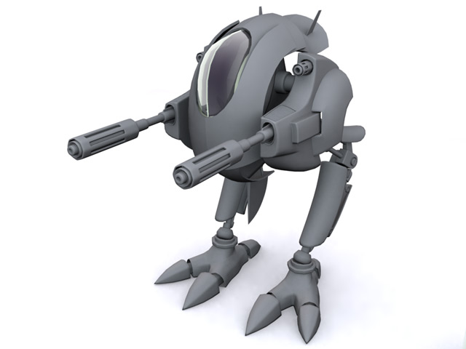
Topic
Bipedal Walker Robot Control based on Reinforcement Learning (RL)

Slide 4
Aim
As a kind of bipedal animals, humans’ walking abilities can be well trained through learning and experience. We try to design a RL model to simulate such learning progresses and show the learning results. In this work, we attempted to solve Bipedal Walker problem from OpenAI’s open source Gym Documentation using reinforcement learning framework. We would first train in normal mode then hardcore mode.

Slide 5

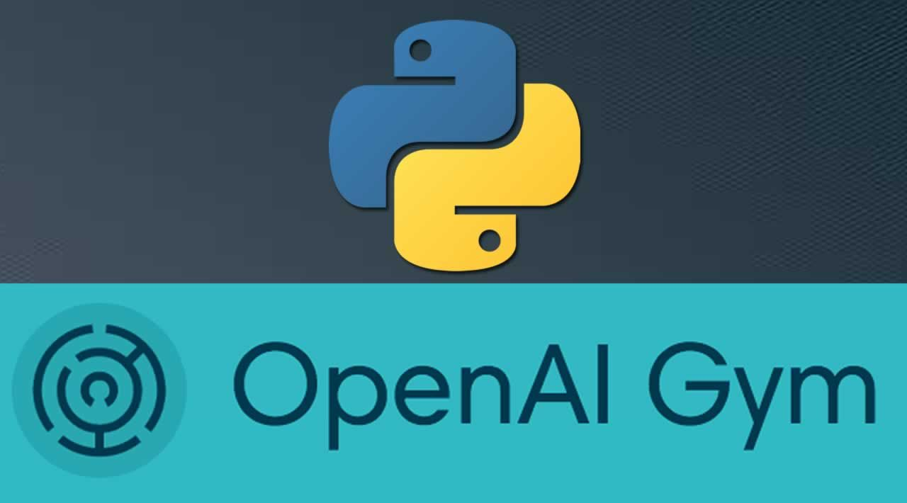
Methods
Openai Gym Keras

Slide 6
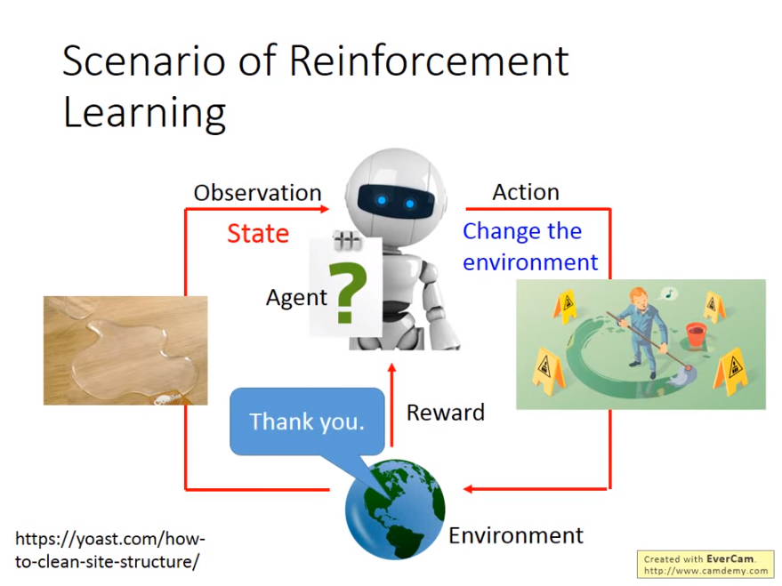
Methods
RL

Slide 7
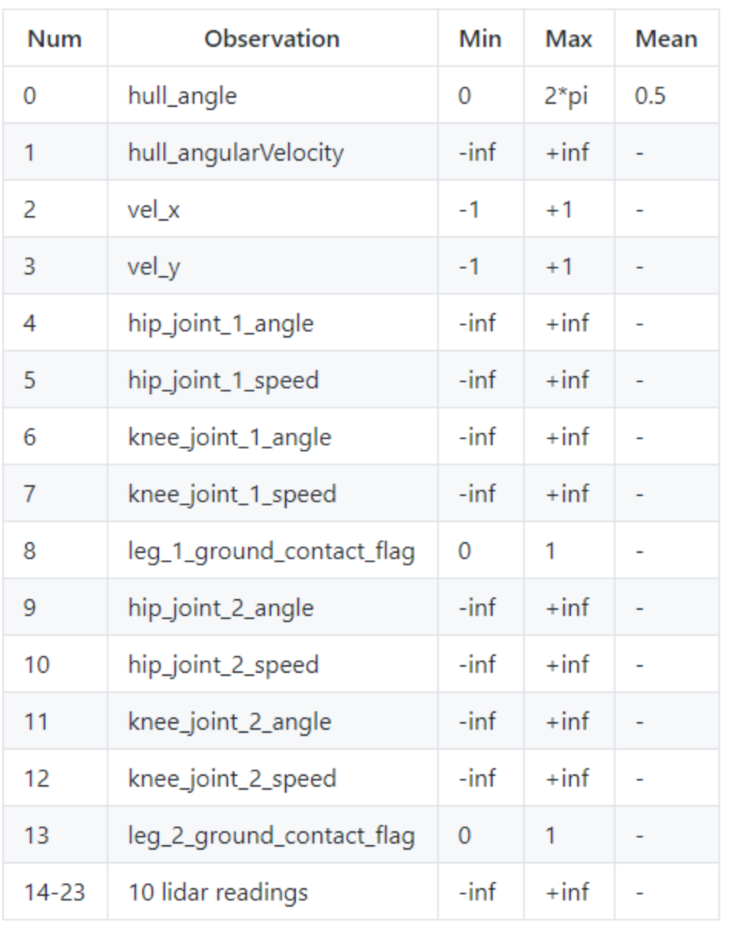
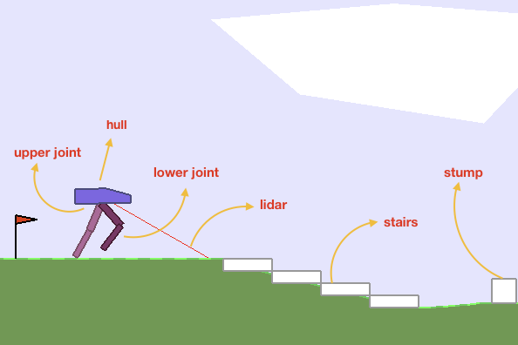
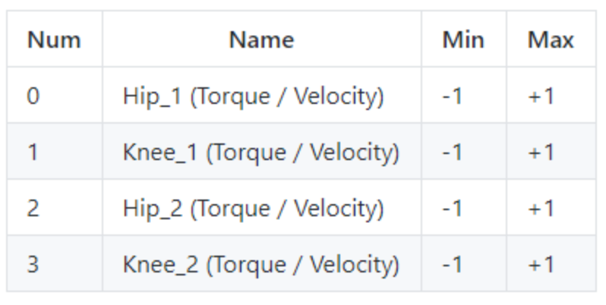
Methods
Observation space & action space
Falling: -100, Operation: minus a little Moving forward to get reward
Notes:
300+

Slide 8
Methods
Model-free: train a model that predicts the reward of this action, if it is accurate enough the agent can play the game easily.
Model-based: model the current environment and the agent learns the properties of the model. (ex. Gravity makes ball falls, the agent can learn that there is gravity so it would catch the ball successfully.

Slide 9
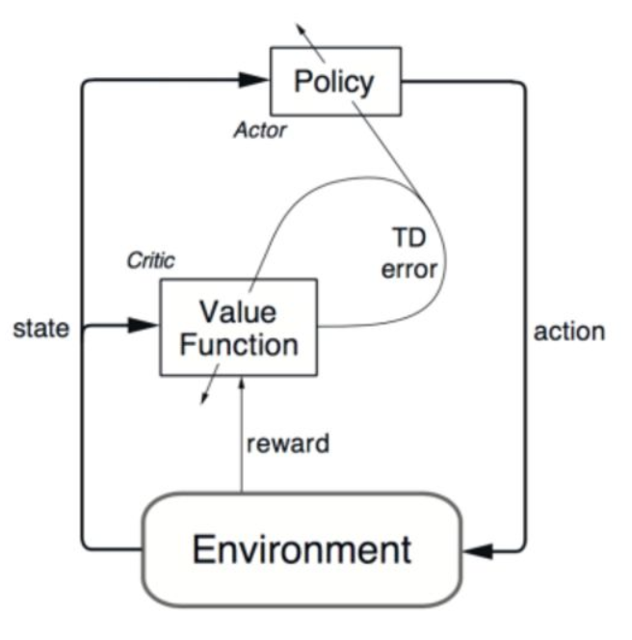
Methods
Actor-Critic: based on Q-learning
An actor makes actions according to policy
A critic estimates the state or action value functions of the current policy
The actor improves the policy based on the value functions.
Notes:
Q-學習是強化學習的一種方法。Q-學習就是要記錄下學習過的策略，因而告訴智能體什麼情況下採取什麼行動會有最大的獎勵值。Q-學習不需要對環境進行建模，即使是對帶有隨機因素的轉移函數或者獎勵函數也不需要進行特別的改動就可以進行。

Slide 10
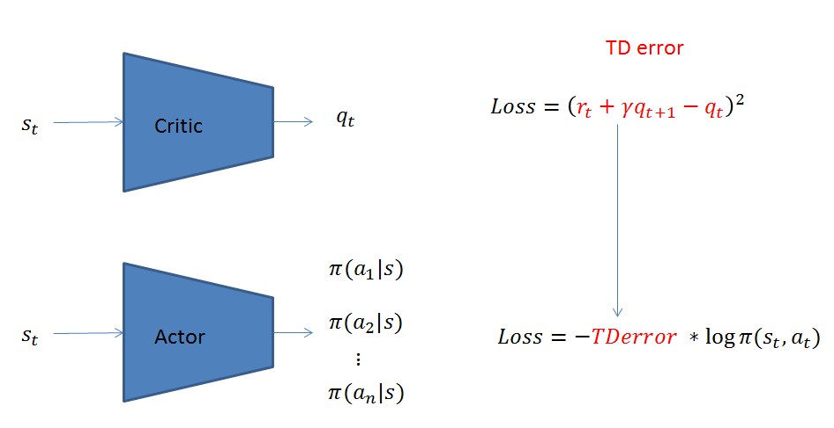
Methods
Notes:
因此，完整的Actor Critic網路表示如下，第一步先用Critic網路算出TD error，第二步再使用TD error對Actor網路進行參數更新

Slide 11
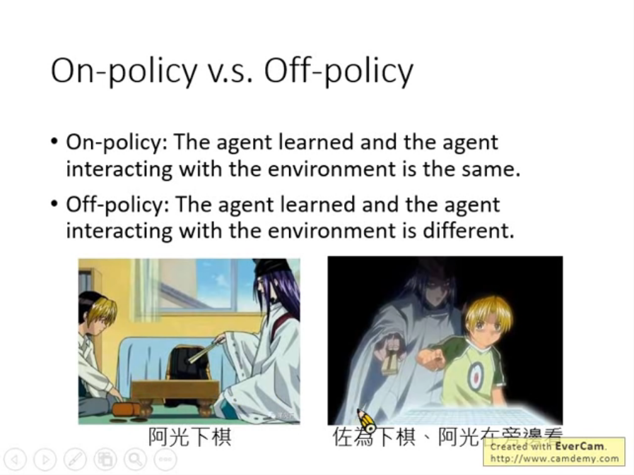
Methods
Proximal Policy Optimization (PPO)
On-policy
Used in solving normal games
Update in a slower rate

Slide 12
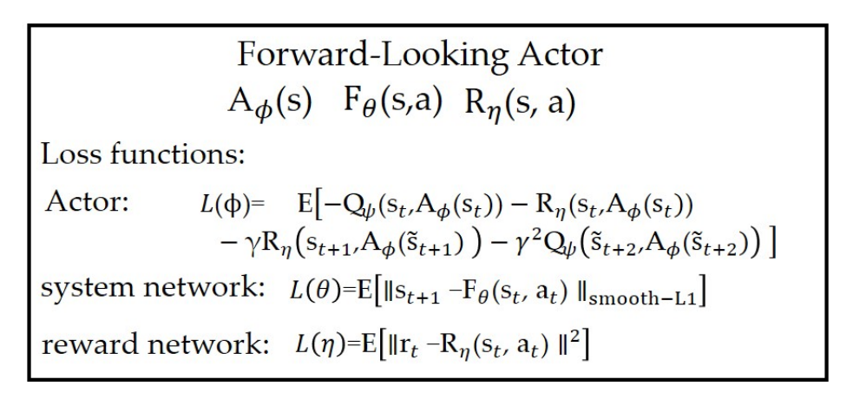
Methods
FORK: A Forward-looking Actor For Model-free Reinforcement Learning
Used in solving hardcore games

Slide 13
Methods
FORK: A Forward-looking Actor For Model-free Reinforcement Learning
The system network F_{θ} : The network is used to predict the next state of the environment, i.e., given current state s_{t} and action a_{t}, it predicts the next state s_{t+1} = F_{θ}(st, at)
The reward network R_{η} : This network predicts the reward given current state s_{t} and action a_{t}, i.e. r_{t} = R_{η}(s_{t}, a_{t})
They are both 3-layered fully connected network

Slide 14

Methods
The FORK agent: a 3-layered fully connected network, as the actor, and the previous reward network R_{η} as critic.
The agent choose the best action at current state according to the forecast of the system network .

Slide 15
Methods
Hyperparameters in FORK:
Activation function: Relu
Optimizer: Adam
lr: 3e-4
Batch_size: 100

Slide 16
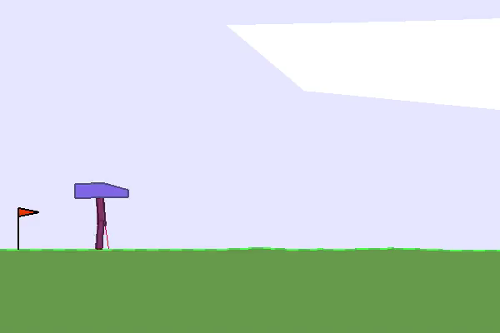
Results
Normal Mode (PPO) – episode 1

Slide 17
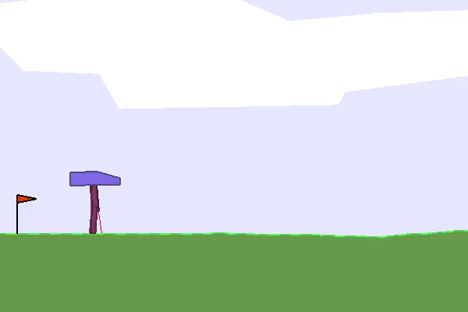
Results
Normal Mode (PPO) – episode 182

Slide 18
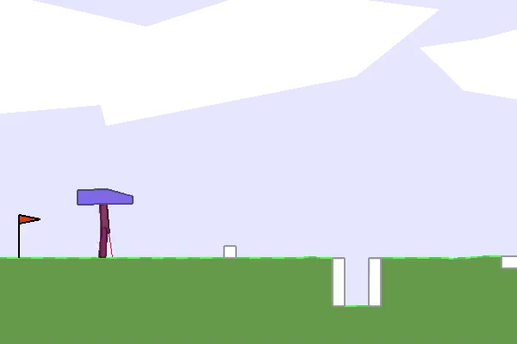
Results
Hardcore Mode (FORK) – episode 1

Slide 19
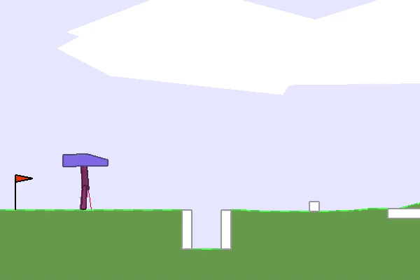
Results
Hardcore Mode (FORK) – episode 401

Slide 20
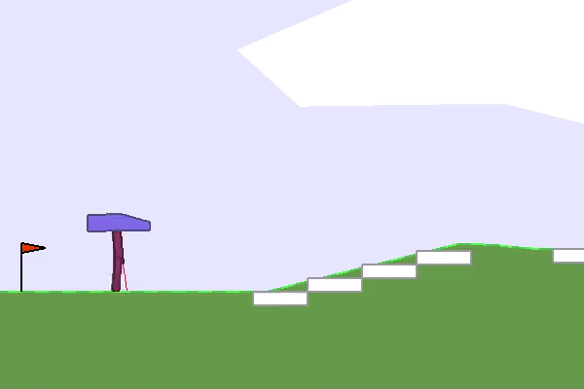
Results
Hardcore Mode (FORK) – episode 1201

Slide 21
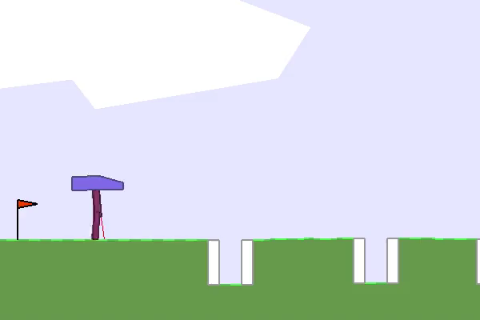
Results
Hardcore Mode (FORK) – episode 1601

Slide 22
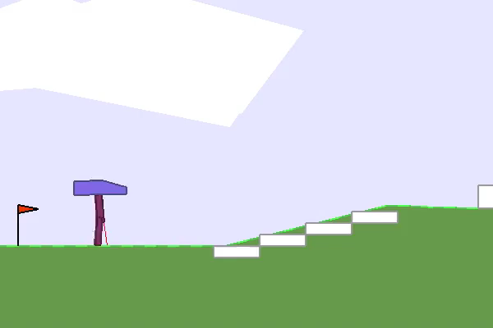
Results
Hardcore Mode (FORK) – episode 2451

Slide 23
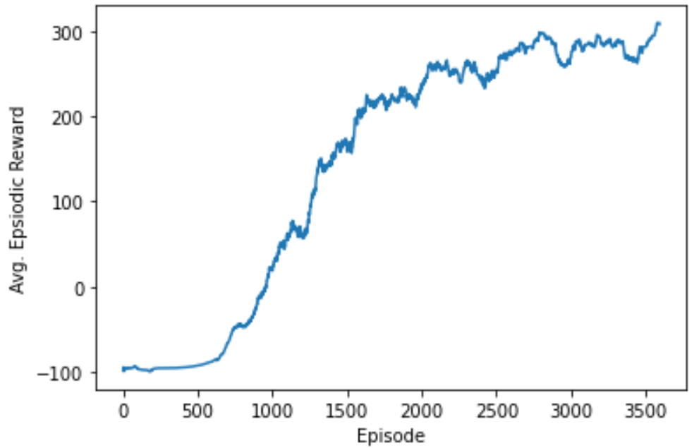
Results
Reward history

Slide 24
References
https://www.gymlibrary.ml/environments/box2d/bipedal_walker/
Özalp, Uğurcan & Uğur, Ömür. (2021). BIPEDAL ROBOT WALKING BY REINFORCEMENT LEARNING IN PARTIALLY OBSERVED ENVIRONMENT. 10.13140/RG.2.2.16487.16805.
FORK: A Forward-Looking Actor For Model-Free Reinforcement Learning https://arxiv.org/abs/2010.01652

Slide 25

Q&A

